Slide 1
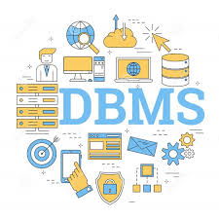
Database Management System
A Database Management System (DBMS) is a software suite that enables users to create, manage, manipulate, and access databases efficiently. It serves as an interface between users and the database, providing mechanisms for data storage, retrieval, modification, and deletion while ensuring data integrity, security, and efficiency.

Slide 2
Key Components of DBMS
Data Definition Language (DDL): Allows users to define the structure of the database, including tables, fields, data types, and constraints.
Data Manipulation Language (DML): Enables users to manipulate the data stored in the database, including inserting, updating, deleting, and querying data.
Data Query Language (DQL): Provides commands for retrieving specific data from the database using queries, such as SELECT statements in SQL (Structured Query Language).
Data Control Language (DCL): Manages access to the database, including permissions, privileges, and security settings to ensure data confidentiality and integrity.

Slide 3
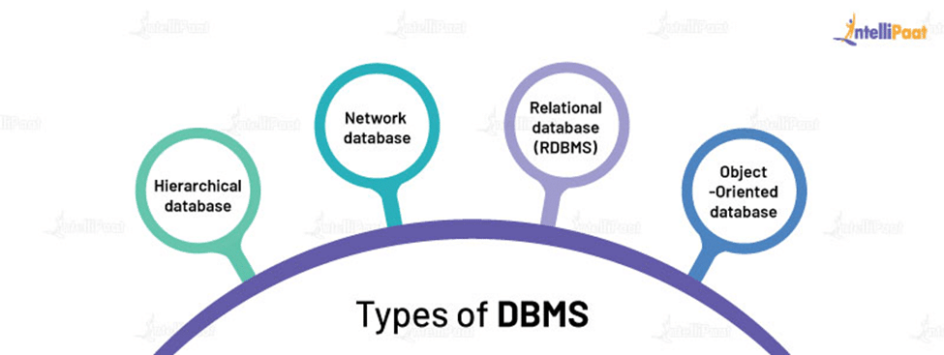
Types of DBMS
Relational DBMS (RDBMS):
Organized into tables with rows and columns.
Examples: MySQL, Oracle, SQL Server.
NoSQL DBMS:
Non-relational databases for unstructured or semi-structured data.
Examples: MongoDB, Cassandra, Redis.
Object-Oriented DBMS (OODBMS):
Stores data in objects as used in object-oriented programming.
Examples: db4o, ObjectDB.
Graph DBMS:
Focus on relationships between data entities.
Examples: Neo4j, OrientDB.

Slide 4
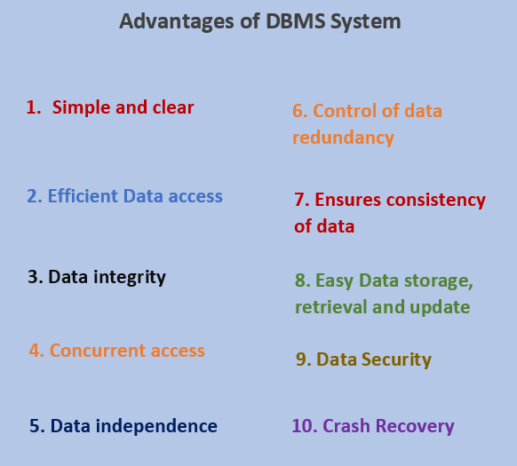
Features and Advantages
Features:
Data Security and Integrity
Data Consistency
Data Independence
Concurrent Access and Transaction Management
Advantages:
Centralized Data Management
Improved Data Sharing
Data Integrity and Security
Backup and Recovery

Slide 5

Challenges and Future Trends
Challenges:
Data Security Threats
Scalability Issues
Data Complexity
Vendor Lock-In
Future Trends:
Big Data and Analytics Integration
Cloud-Based DBMS
Blockchain for Data Integrity
AI and Machine Learning in DBMS

